Slide 1
Random Forest

Slide 2
Random Forest
Random forest is a type of machine learning algorithm
Machine learning algorithms build a model based on training data in order to make predictions without being explicitly programmed to perform the task
Machine learning methods represent a branch of statistics that can be used to automatically extract information from available data, including the non-linear and hidden relationships
It belongs to the decision-tree class of models
This method is suitable for digital soil mapping under limited and sparse scenarios of data availability

Slide 3
Decision trees
Random forests are composed of decision trees
Figuratively speaking the trees are upside down, with the root node (the first variable) at the top and the leaves (the predictions) at the bottom
Sugar | Exercise | Diabetes
Yes | No | Yes
Yes | Yes | No
No | Yes | No
No | No | No
Yes | No | ?
Eats a lot of Sugar
Root node
True
False
Diabetes: 20 5 Yes No
Exercises Regularly
Leaf
Tree
True
False
Diabetes: 15 30 Yes No
Diabetes: 29 56 Yes No

Slide 4
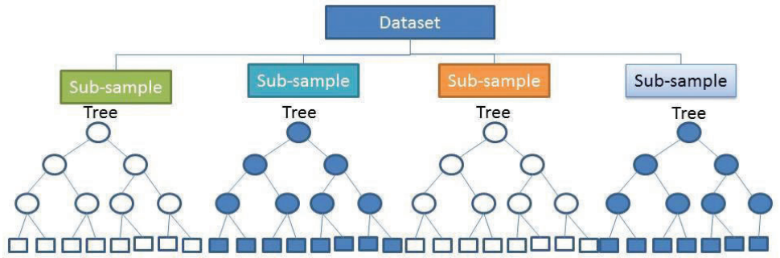
Random Forest
Random forests are composed of hundreds of these decision trees consisting of randomly selected predicting variables and randomly selected subsamples
Each single tree makes a prediction and the final average is obtained by taking the average of each tree

Slide 5
Random Forest - Bootstrapping
Each tree (generated using a different subset of available data and random combinations of the prediction factors) is internally evaluated by an out-of-bag cross validation
Training subset (bootstrapping)
Overweight | Eats a lot of sugar | Exercises | Diabetes
Yes | Yes | No | Yes
Yes | No | Yes | No
Yes | Yes | Yes | Yes
No | No | No | No
No | Yes | No | No
Overweight | Exercises | Diabetes
Yes | Yes | No
Yes | Yes | No
No | No | No
No | Yes | No
No | No | No
These two data sets were not used to build the tree and will be used for validation

Slide 6
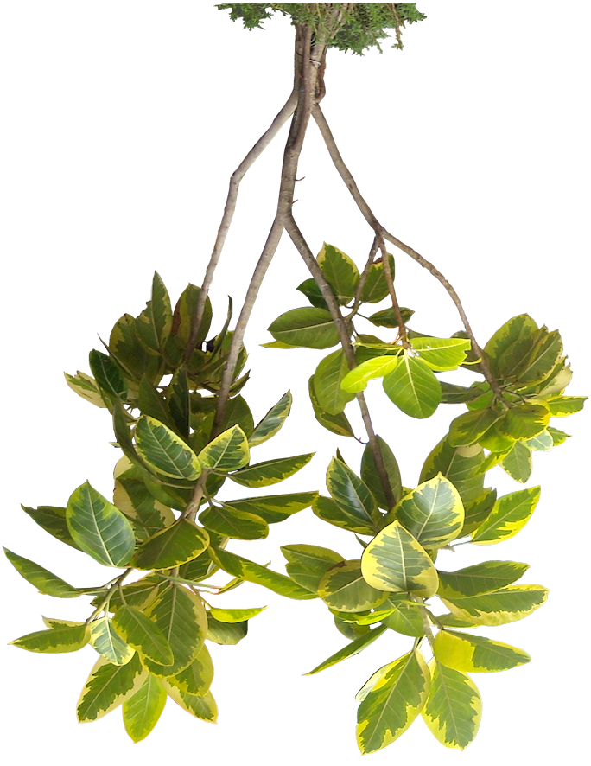
The trees in a Random Forest
Random forests are used both for predicting categorical outcomes (e.g. to diagnose medical conditions) and for predicting continuous data like soil organic carbon
Classification trees are used to predict categorical data
Regression trees are used for continuous data by recursively splitting the data

Slide 7
Random Forest for continuous data
In linear regression a model is fitted to the entire dataset 🡪it cannot detect complex relationships
In a regression tree the data is split into specific groups that correspond to certain thresholds of predictors (covariates) of each tree
The prediction of the single tree is made based on the mean of the observed samples in the leaf
The prediction of the random forest is made by taking the average of the predictions of the single trees
Precipitation > 400 mm
Root node
True
False
Elevation >500
Daily Temp. August < 25 ° C
True
False
True
False
SOC 32 t/ha (31)
SOC 50 t/ha (25)
SOC 29 t/ha (10)
SOC 10 t/ha (3)
( ) → number of observations in each final split

Slide 8
Random Forest workflow:
Get the previously prepared covariates and data to create a regression matrix
Create a random forest model and explore parameters
Explore which variables are more relevant in the model
Predict SOC with our random forest model

Slide 9
Random Forest -Data prep
# Set working directory
setwd("C:\\Users\\Macedonia")
# Load the covariates stack. It was was prepared in the #'data_preparation_covariates' script
load(file = "02-Outputs/covariates.RData")
names(covs)
# Load the processed data for digital soil mapping. This table was #prepared in the 'data_preparation_profiles' script
dat <- read.csv("02-Outputs/dat_train.csv")
names(dat)

Slide 10
Random Forest - Data prep
# extract values from covariates to the soil points
coordinates(dat) <- ~ X + Y
dat <- extract(x = covs, y = dat, sp = TRUE)
summary(dat)
# Remove NA values
dat<-as.data.frame(dat)
dat <- dat[complete.cases(dat),]
str(dat)
# LandCover and soilmap are categorical variables, they need to be #'factor'
dat$LandCover <- as.factor(dat$LandCover)
dat$soilmap <- as.factor(dat$soilmap)
str(dat)

Slide 11
Random Forest
# Save the final table and all the covariates
write.csv(dat, "02-Outputs/SOC_RegMatrix.csv", row.names = FALSE)
Due to the randomness component of Random Forest we’re going to use the set.seed() function
# Define the random numbers table (to get reproducible result)
set.seed(12042019)

Slide 12
Random Forest
Now we’re going to transform our data frame into a SpatialPointsDataFrame and set the coordinate system to WGS84
To use the randomForest() function we first need to define a formula of the data and covariates with the function fm()
library(sp)
# Promote to spatialPointsDataFrame and set the coordinate system
coordinates(dat) <- ~ X + Y
proj4string(dat) = CRS("+init=epsg:4326") # WGS84 ;names(data)
# We need to define a formula for the model
fm = as.formula(paste("OCS ~", paste0(names(covs),
collapse = "+")))
fm #check the model

Slide 13
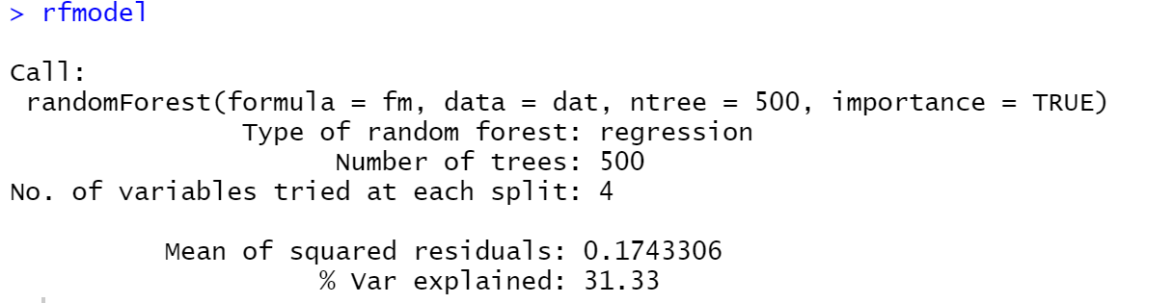
Random Forest - model
Now we’re going to create the random forest model with the randomForest() function
# Run the Random Forest model and explore the results
library(randomForest)
rfmodel <- randomForest(fm, data=dat, ntree=500, importance=TRUE)
rfmodel

Slide 14
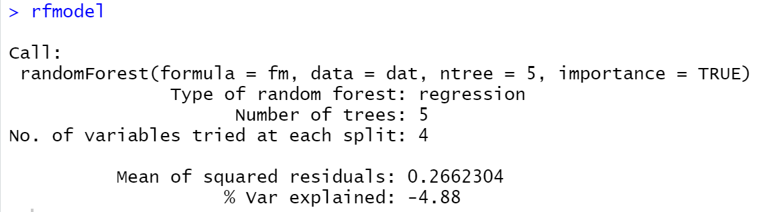
Explore the model
Now we will explore what happens when we change the number of decision trees within out random forest
The default of 500 trees produces a better model than a random forest with only 5, please change it back to 500
If we were using another package (caret) we could change mtry (number of variables per tree)
rfmodel <- randomForest(fm, data=dat, ntree=5, importance=TRUE)
rfmodel

Slide 15
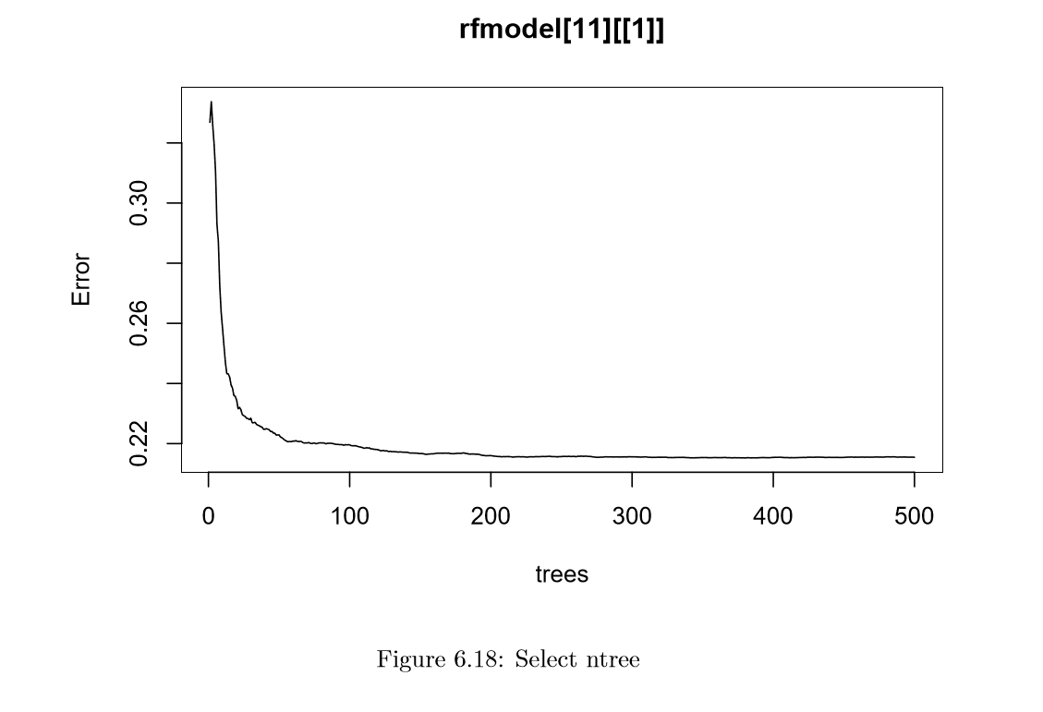
ntree parameter

Slide 16
Explore the model
The default of 500 trees produces a better model than a random forest with only 5, please change it back to 500

Slide 17
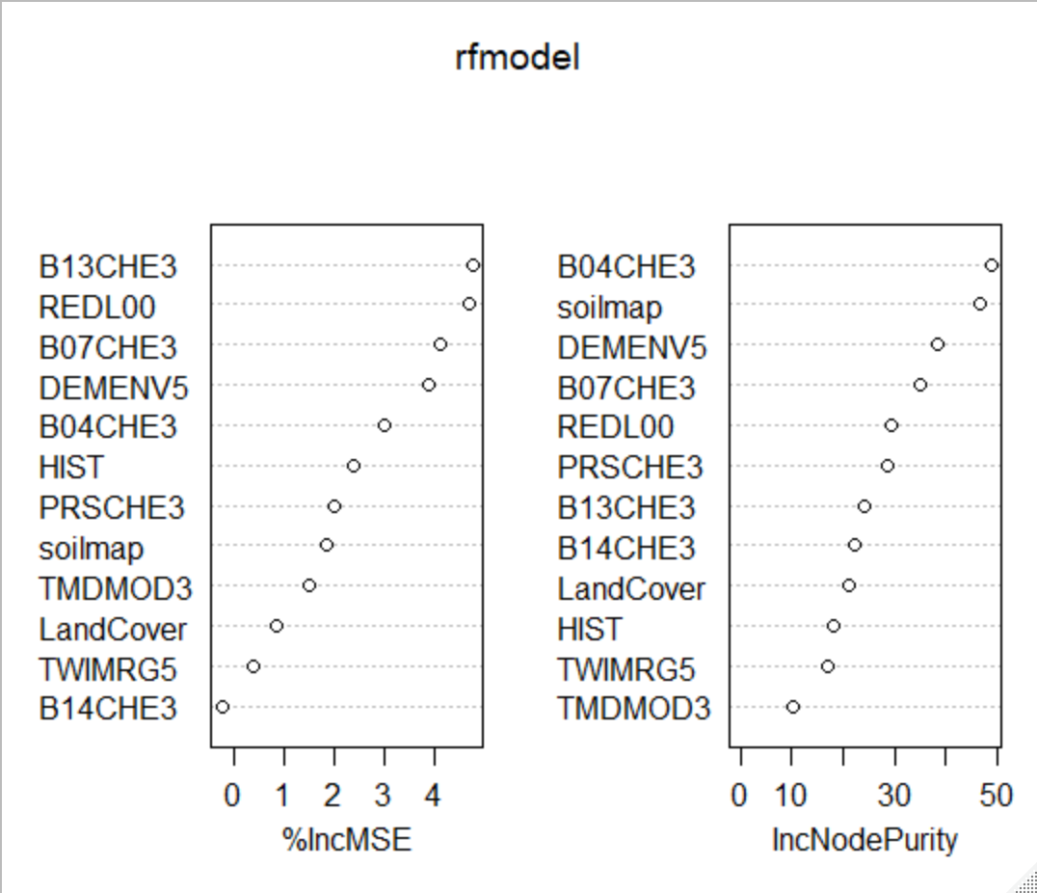
Covariate Importance
Now we will explore which covariate is more relevant within the model with the varImpPlot() function
The first graph shows how the mean squared error increases within the entire model if a covariate is excluded
The second graph shows which covariate is more decisive for splitting the data into
homogenous data groups
(measured with residual sum
of squares (RSS)
# Explore the importance of
#covariates in the model
varImpPlot(rfmodel)

Slide 18
Predict SOC with RF model
Finally we will run our model to predict SOC
A uncertainty map can be created by using quantile regression forest (for more info refer to the SOC mapping cookbook)
# Make a prediction across all Macedonia
pred <- predict(covs, rfmodel)
# Explore and save the result as a tiff file
plot(pred)
writeRaster(pred, filename = "02-Outputs/Final Maps/MKD_OCS_RF.tif", overwrite=TRUE)

Slide 19
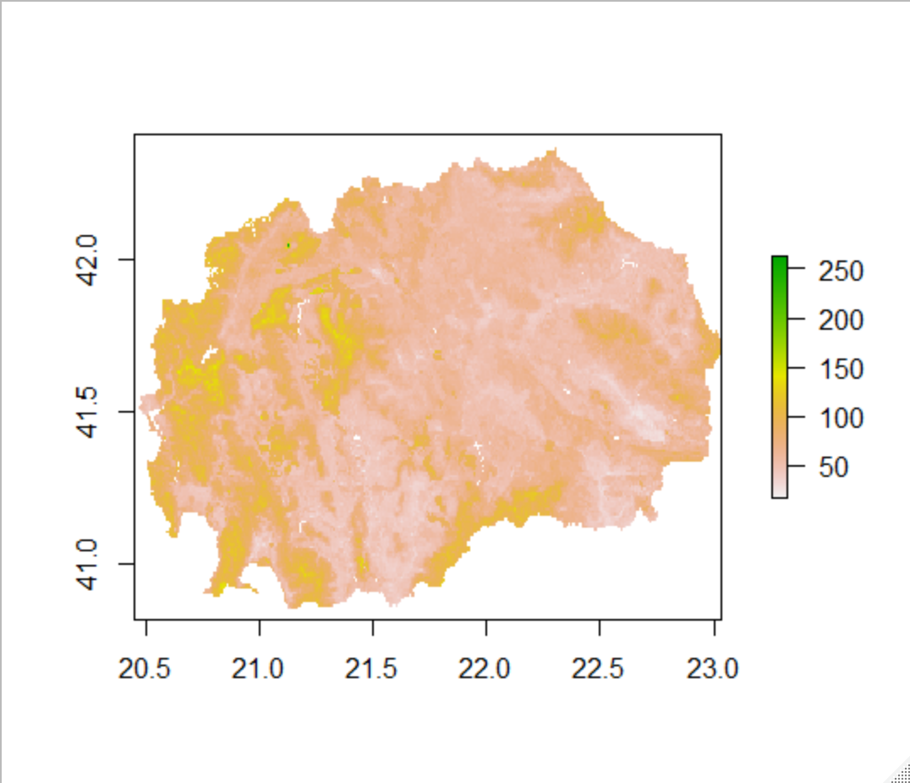

Slide 20
Exercise: clay
Random Forest

Slide 21
Thank you!

